Slide 1
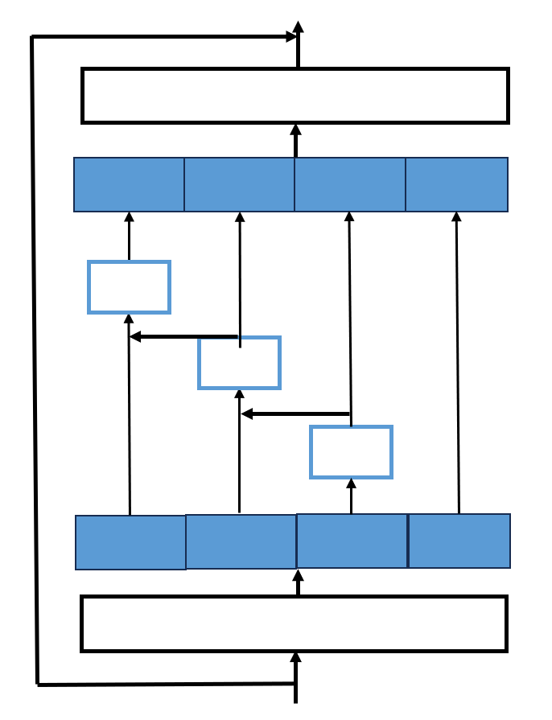
1 × 1
1×1
GELU
FFN
Y4
Y3
Y2
Y1
d, 3×3
BN
3×3
1 × 1
3×3
3×3
1 × 1
Attention
Y4
X3
X2
X1
LKA
1×1
BN
GELU
1 × 1

Slide 2
1 × 1
GELU
FFN
d, 3×3
BN
1 × 1
1 × 1
1 × 1
Attention
K × K, DW
RepLKBlock
1 × 1
BN
GELU
BN
1 × 1

Slide 3
LKA, 5
LKA, 7
LKA
LKA
LKA, 9
MultiBranch

Slide 4
1 × 1
GELU
FFN
d, 3×3
BN
1 × 1
1 × 1
Attention
LKA
BN
GELU
1 × 1

